Slide 1
AP Biology Calculations: Standard Deviation and Standard Error

Slide 2
Standard Deviation:
A measure of how spread out the data is from the mean

Slide 3
Lower standard deviation:
Data is closer to the mean
Greater likelihood that the independent variable is causing the changes in the dependent variable
Higher standard deviation:
Data is more spread out from the mean
More likely factors, other than the independent variable, are influencing the dependent variable

Slide 4
σ = standard deviation
68% of data fall within ±1s of mean
95% of data fall within ±2s of mean
99% of data fall within ±3s of mean

Slide 5
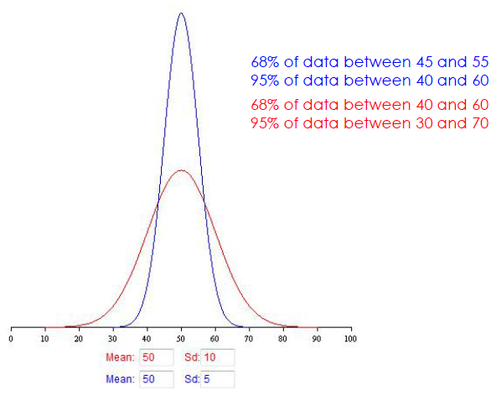
The magnitude of the standard deviation depends on the spread of the data set
Two data sets: same mean; different standard deviation

Slide 6
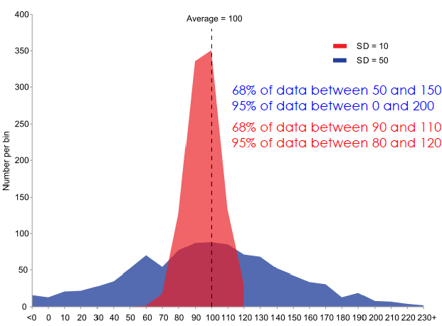
Actual data sets aren’t always so pretty...

Slide 7
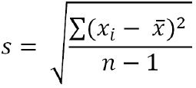
Calculating standard deviation, s
Calculate the mean (x)
Determine the difference between each data point, and the mean
Square the differences
Sum the squares
Divide by sample size (n) minus 1
Take the square root

Slide 8
Lets Do this together
You have found the following ages (in years) of all 444 gorillas at your local zoo:
7, 10, 15, 21
What is the average age of the gorillas at your zoo? What is the standard deviation? Round your answers to the nearest tenth.

