Slide 1
The Mixture Project

Slide 2
Sweet Pea Lotion
Questions | Carbomer | Limonene | Linalool | Glycerin | Dimethicone
Alternative Names | carbo-benzene | Carvene, Cinene, Dipentene, Methyl-4-isopropenyl cyclohexene, Cajaputene, and Efchole. | linaloyl | Glycerol Monostearate | polydimethylsiloxane
Purpose or properties | Applications in medicine and hygiene | Produces the Fragrance smell | Usually used as the scent | It is used as a solvent and a plasticiser. | It acts as a skin protectant and emollient, appearing as an ingredient in many over-the-counter moisturizing lotions and skin creams.
Hazards | can be highly irritating to skin and eyes and may have a permeating effect on skin. | Inflammation of the eye is characterized by redness, watering, and itching | Gives off irritating or toxic fumes | Side effects of glycerin enemas and suppositories include anal irritation, burning sensation, diarrhea, gas, nausea and stomach cramps Read more: Glycerine Hazards | eHow.com http://www.ehow.com/list_7369871_glycerine-hazards.html#ixzz2Ob6zcHpp | One area that has raised concern is the use of the substance as a filling for breast implants.

Slide 3
Honey Buns
Questions | Barley Malt | Palm Oil | Riboflavin | Dextrose | Starch
Alternative Names | Cereal Fiber, Dietary Fiber, Fibre Alimentaire | PHPKO | vitamin B2 | Glucose | carbohydrate, sugar
Purpose | Sweetener | Palm oil is used for preventing vitamin A deficiency; and treating malaria, high blood pressure, and cyanide poisoning. As food, palm oil is used for frying. | Riboflavin (vitamin B2) works with the other B vitamins. It is important for body growth and red blood cell production and helps in releasing energy from carbohydrates. | Dextrose is used as a sweetener and added artificial sweeteners as a filler. | A way to store excess glucose.
Hazards | High cholesterol | Palm oil contains saturated and unsaturated fats, vitamin E, and beta-carotene. It might have antioxidant effects. | Anemia Mouth or lip sores Skin disorders Sore throat | Because dextrose is a simple carbohydrate, very much like granulated sugar, taking dextrose in excess via any type of fitness powder supplement can lead to weight gain. | Inhalation: May cause respiratory tract irritation.

Slide 4
The original products

Slide 5
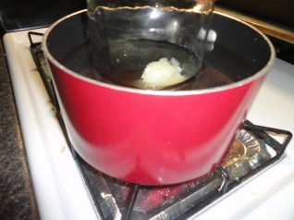
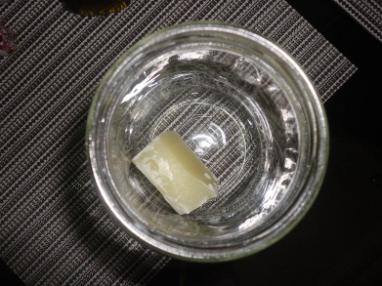
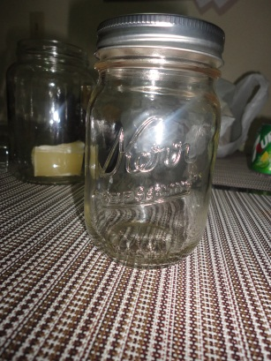
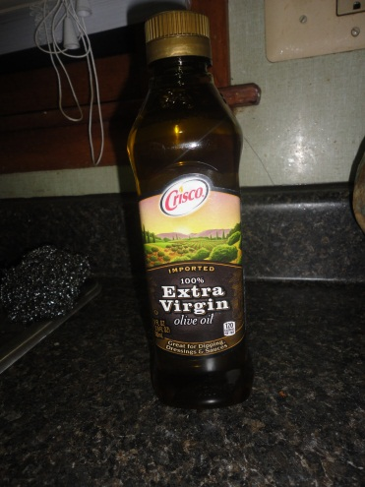
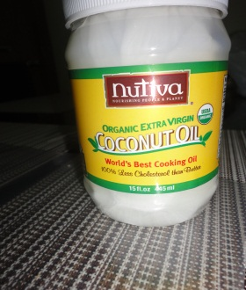
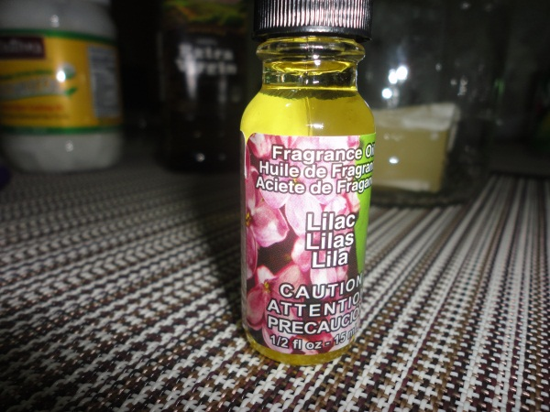
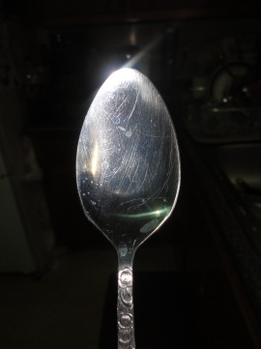
Homemade Lotion
Olive oil
Coconut oil
Beeswax
Masons jar
Pot
Water
Mixing spoon

Slide 6
The process
Put all ingredients in a glass container
Get a medium sauce pan filled with water half way
Put the water to a medium heat
Place the glass container in the pot of water, put a lid on the container
Let the ingredients heat up for one to two min. before stirring
Keep a constant stir
When all ingredients are melted you can transfer liquid into a new container and let it harden

Slide 7
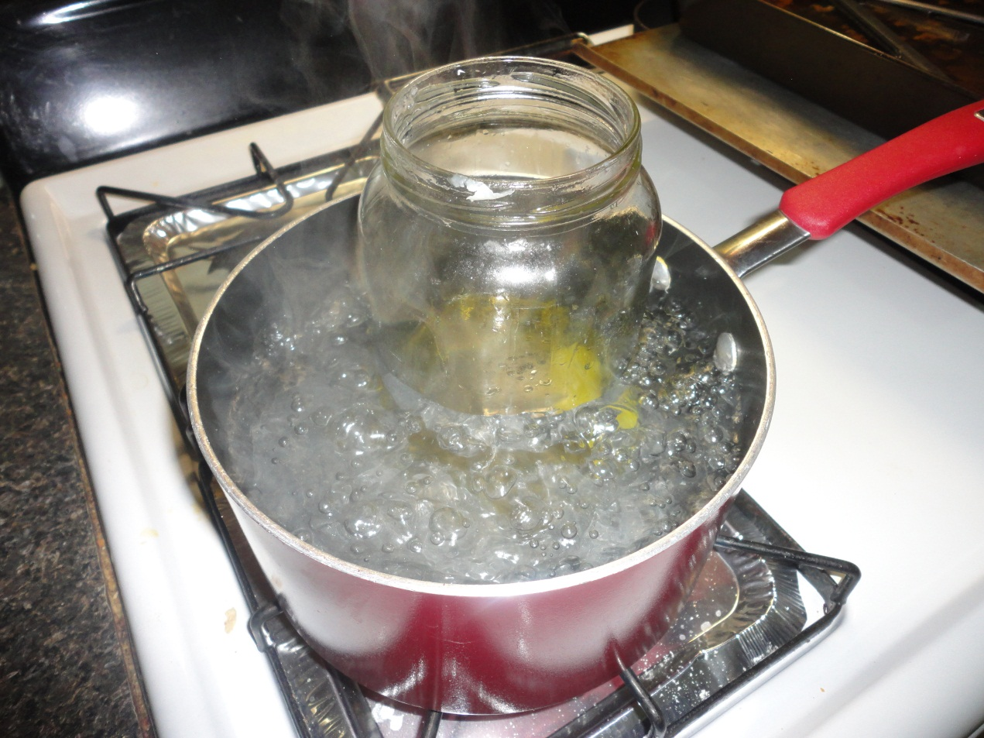
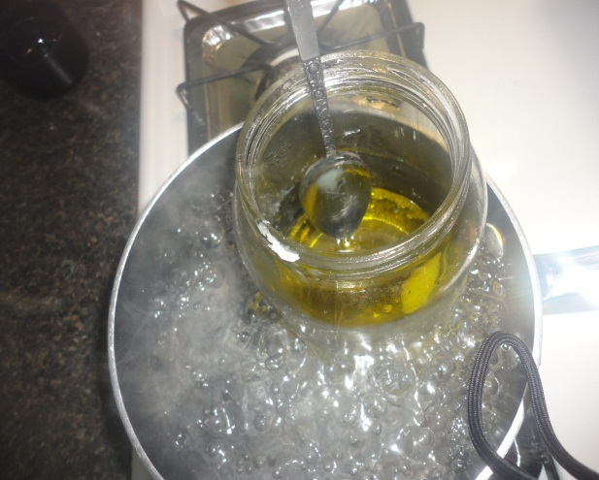
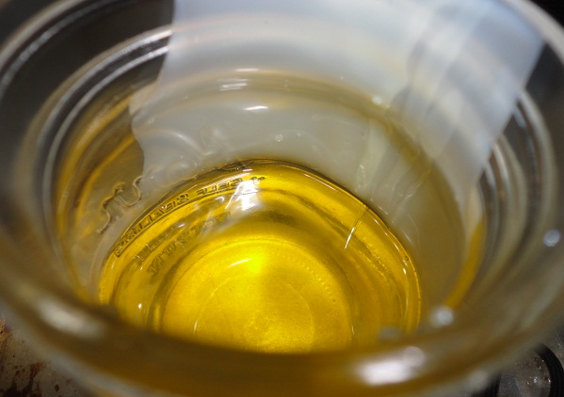
The steps

Slide 8
The finished product

