Slide 1
Introduction to Nutrition
~ Wellness is a Way of Life ~
Freshman Health

Slide 2
TURN AND TALK TO YOUR NEIGHBOR:
WHAT FACTORS PLAY A ROLE IN YOUR FOOD SELECTIONS AND EATING BEHAVIORS?
Notes:
You can have students get up and move around the room to share their response with their classmates.

Slide 3
Assessing Eating Behavior
A What is more appealing? B
Is this your Hunger or Appetite?

Slide 4
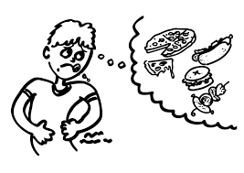
Appetite vs Hunger Compare/Contrast in the space provided
Appetite-is the desire rather than the need for food
Hunger-is the body's physical response to the need for food

Slide 5
Assessing Eating Behavior
Appetite
Personal preferences
Ethnic heritage
Social interactions
Emotional comfort
Discuss & explain 3
Availability
Habit
Values
Body image
Nutrition

Slide 6
Which is Healthier & Why? Record your response.
Notes:
830 calories 25 grams of fat 6g sat fat –McDonalds meal
1,300 calories 86 g fat 28g sat fat- Chilis meal

Slide 7
In your notes, write down the last three things you have eaten over the past 24 hours. Explain to your group how healthy these foods were.

Slide 8
Define Nutrients:
Substances found in foods….

Slide 9
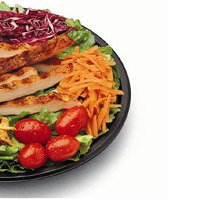
6 Classes of Nutrients
Carbohydrates
Proteins
Fats
Vitamins
Minerals
Water
Which are energy giving & which
are not?
Notes:
These are the 6 classes of nutrients. Each nutrient plays a different role and is required for life. Nutrients are substances the body needs in order to regulate bodily functions, promote growth, repair body tissue, and obtain energy. Carbohydrates, fats and proteins are the nutrients used for energy.

Slide 10
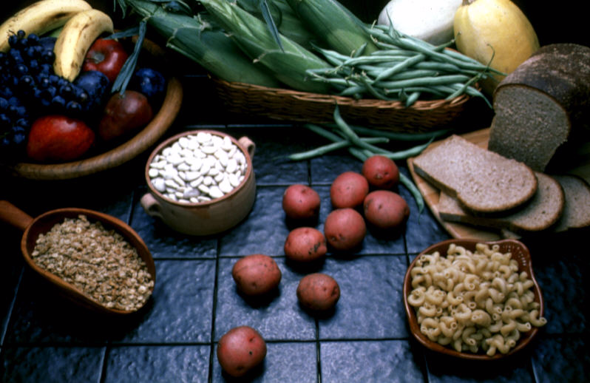
Carbohydrates: What have you eaten today?
Carbohydrates
Best fuel – they provide energy
Simple sugars
Glucose (monosaccharide)
Fructose (monosaccharide)
Sucrose (disaccharide)

Slide 11
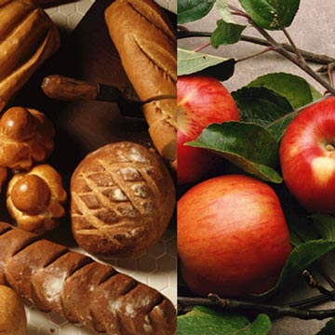
Carbohydrates
Simple
individual glucose or fructose molecules
Complex
Chains of glucose molecules
List 3 simple & 3 complex carbs.
**Why whole grains?**
Notes:
There are two different types of carbohydrates. Simple and complex carbohydrates are both composed of glucose or fructose molecules but they differ in how they are put together.
Simple carbohydrates exist as independent glucose or fructose molecules whereas complex carbohydrates are connected in chains. Because of these differences simple and complex carbohydrates are processed very differently by the body (discuss insulin effect from simple carbs)
With the exception of fruit simple carbohydrates are typically known as “empty calories” because they contain nothing but calories. Complex carbohydrates, on the other hand, contain a variety of vitamins, minerals and fiber.

Slide 12
Protein
Proteins provide our body with the building blocks it needs to grow.
They also maintain and replace body tissue, such as muscles, bones, blood, and body organs.
Key element in antibodies
What food contains high protein that isn’t a meat?

Slide 13
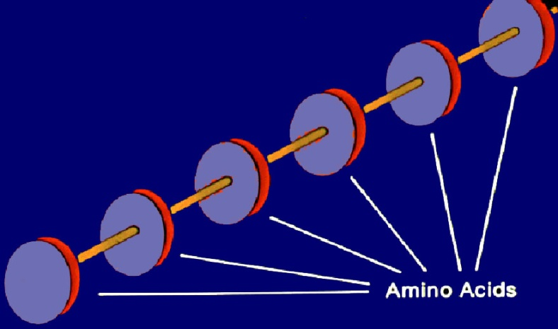
Types of Protein
Sources of Protein
Animal (complete)
meats, dairy
Vegetable (incomplete)
beans, nuts, legumes, grains
Types of Amino Acids
Nonessential (14) – can be made by body
Essential (8) – are not made by body
Amino acids linked together
Notes:
There are two primary sources of protein.
Animal protein is considered “complete” because it has all of the essential amino acids and other non-essential ones.
Vegetable protein is considered an “incomplete” source because it doesn’t contain all of the essential amino acids. This is why vegetarians must consume a variety of foods to get the protein they need. The best sources of protein are poultry, fish, eggs, low fat dairy products (if over the age of two), nuts, seeds, and legumes like black beans and lentils.
This slide shows conceptually how amino acids are linked together to make proteins. By linking the amino acids in different orders the protein takes on different properties.

Slide 14
Fat
Maintain healthy skin
Insulate body organs
Maintain body temperature
Promote healthy cell function
Are a concentrated form of energy
95% as triglycerides in the body
What does fat soluble mean?

Slide 15
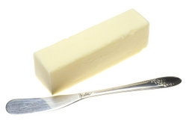
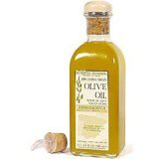
Types of Fats
Saturated
Animal sources
Solid at room temperature
Unsaturated (poly- or mono-)
Vegetable sources
Liquid at room temperature
Define the difference
Poly & mono fats.
Notes:
These are the major sources of fat in the body.
The difference between saturated and unsaturated fats can be explained with the diagram. The diagram shows an unsaturated fat because the carbon chain can accept hydrogen bonds instead of the carbon-carbon double bond.

Slide 16
Recommendations for Fat Consumption
Dietary Fat Recommendations
Less than 30% of calories in diet from fat
Less than 1/3 of dietary fat should be saturated
Ways to Decrease Intake of Fat
Minimize "fast" foods
Minimize processed foods
Use leaner cuts of meats and trim off visible fat/skin
Use low fat alternatives
Decrease use of condiments
I.D. 3 foods that have “healthy” fats.
Notes:
Follow these steps to reduce fat content in the diet.

Slide 17
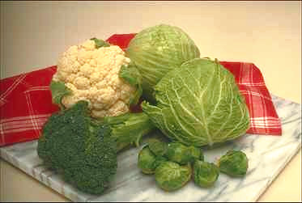
Vitamins
Organic substances that regulate numerous and diverse physiological processes in the body
Do not contain calories
List two types
Fat soluble
Water soluble
Notes:
Fat Soluble can be stored in the body, water soluble cannot, and that is why it is important to get these vitamins through your diet everyday.

Slide 18
Vitamins: Function /Found In
With yourgroup, look up two of the following vitamins for their function and what foods they are found in abundance:
Vitamin A Vitamin B Vitamin C
Vitamin D Vitamin E Vitamin K
Folic Acid
Bonus: Identify symptoms of deficiency

Slide 19
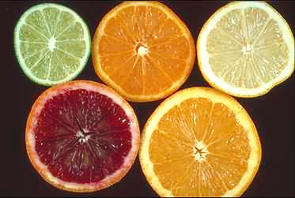
Minerals
Define minerals:
About 25 are essential
Classified as major or trace minerals
RDA’s have only been
determined for 7 minerals
Do not contain calories
Notes:
Minerals

Slide 20
Minerals: Function/Found In
With yourgroup, look up two of the following minerals for their function and what foods they are found in abundance:
Calcium Iron Potassium
Magnesium Phosphorus Zinc
Bonus: Identify symptoms of deficiency

Slide 21
Water (8 to 14 ounces/day)
Comprises about 60% of body weight
Chief component of blood plasma
Aids in temperature regulation
Lubricates joints
Shock absorber in eyes, spinal cord, and amniotic sac (during pregnancy)
Active participant in many chemical reactions
Does not contain calories
Do you drink more water or soda?
Notes:
Water serves a variety of functions in the body

Slide 22
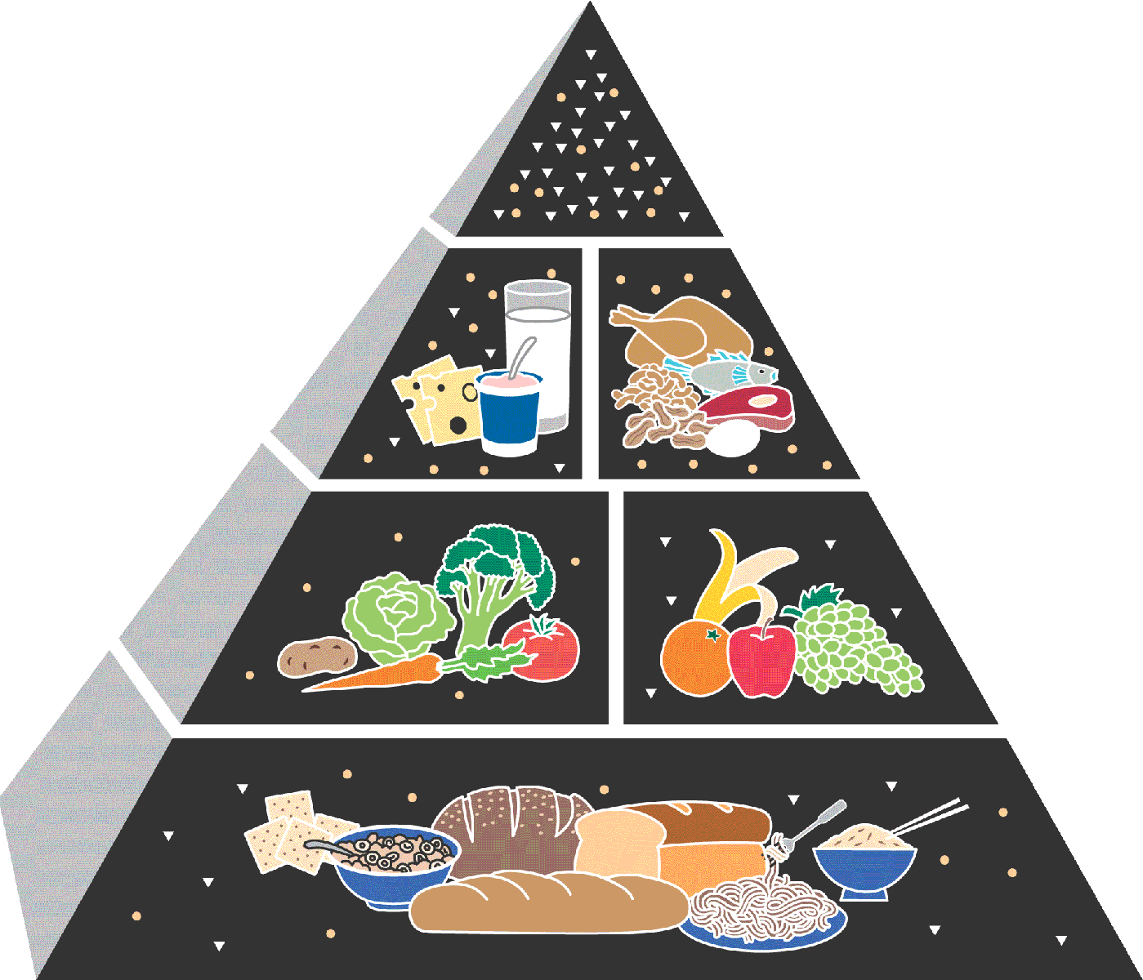
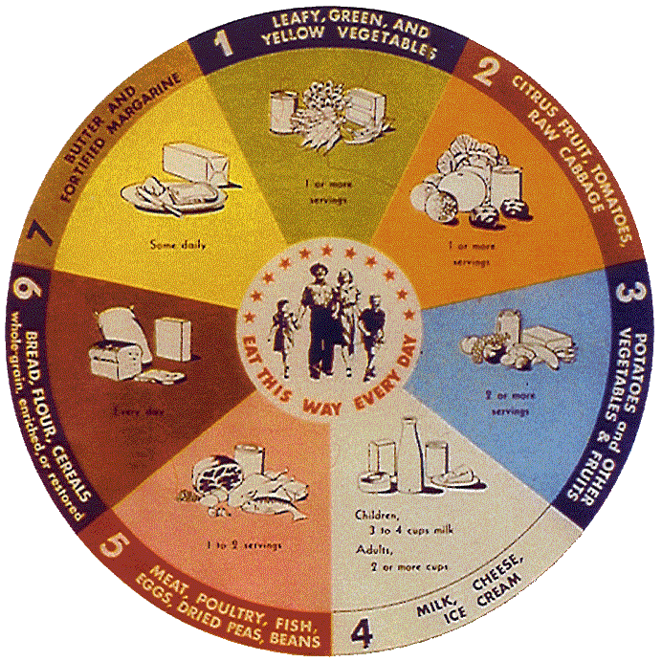
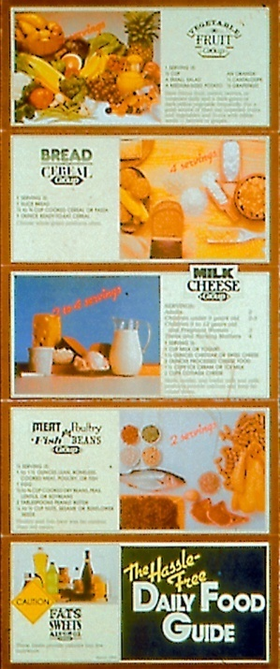
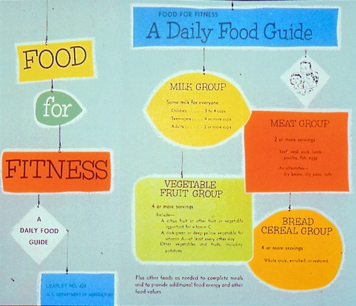
History of USDA’s Food Guidance
Food for Young Children
1992
1916
1940s
1970s
2005
1950s-1960s
Notes:
USDA has had a long history with food guidance dating back into the early 20th century.
Looking back over this history, many different food guides have been used. They represented health and nutrition concerns of the time when they were introduced.
For example,
In the 1940’s the wartime food guide promoted eating foods that provided the vitamins and minerals needed to prevent deficiencies.
In the 1950’s-1960’s the 7 food groups were simplified into a “Food for Fitness” guide, which was commonly called “The Basic Four.”
By the later 1970’s, concerns about dietary excess lead USDA to issue “The Hassle-Free Daily Food Guide,” which included a “caution” group of fats, sweets, and alcohol.
All of these food guides preceded the introduction of the original Food Guide Pyramid in 1992.
NOTE TO PRESENTER: The food guides pictured above are--
1916: Food for Young Children
1940s (1946): National Food Guide (commonly called “The Basic Seven”)
1950s-1960s (1956): Food for Fitness—A Daily Food Guide (commonly called “The Basic Four”)
1970s (1979): Hassle-Free Guide to a Better Diet
1992: Food Guide Pyramid
2005: MyPyramid

Slide 23
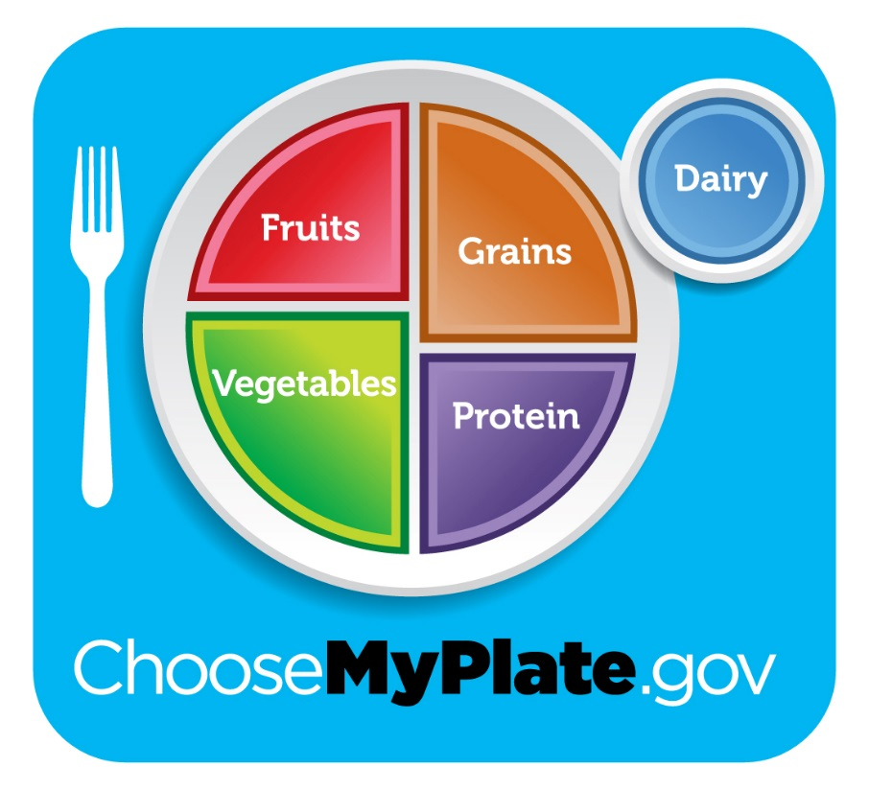
--2011-- Choosemyplate.gov
Notes:
MyPyramid was released in April 2005. MyPyramid retains all the food groups from the original Pyramid, but it also includes a graphic representation of physical activity—an important additional recommendation for a healthy way of life.

Slide 24
Chosemyplate
ABCNEWS (Take Notes)

Slide 25
How is this different?
My Plate illustrates the five food groups that are the building blocks for a healthy diet using a familiar image – a place setting for a meal.
Before you eat, think about what goes on your plate or in your cup or bowl. To learn more about building a healthy plate, select a food group below & take notes.
Fruits | Vegetables | Grains | Protein Foods | Dairy
Focus on fruits. | Vary your veggies. | Make at least half your grains whole. | Go lean with protein. | Get your calcium-rich foods.

Slide 26
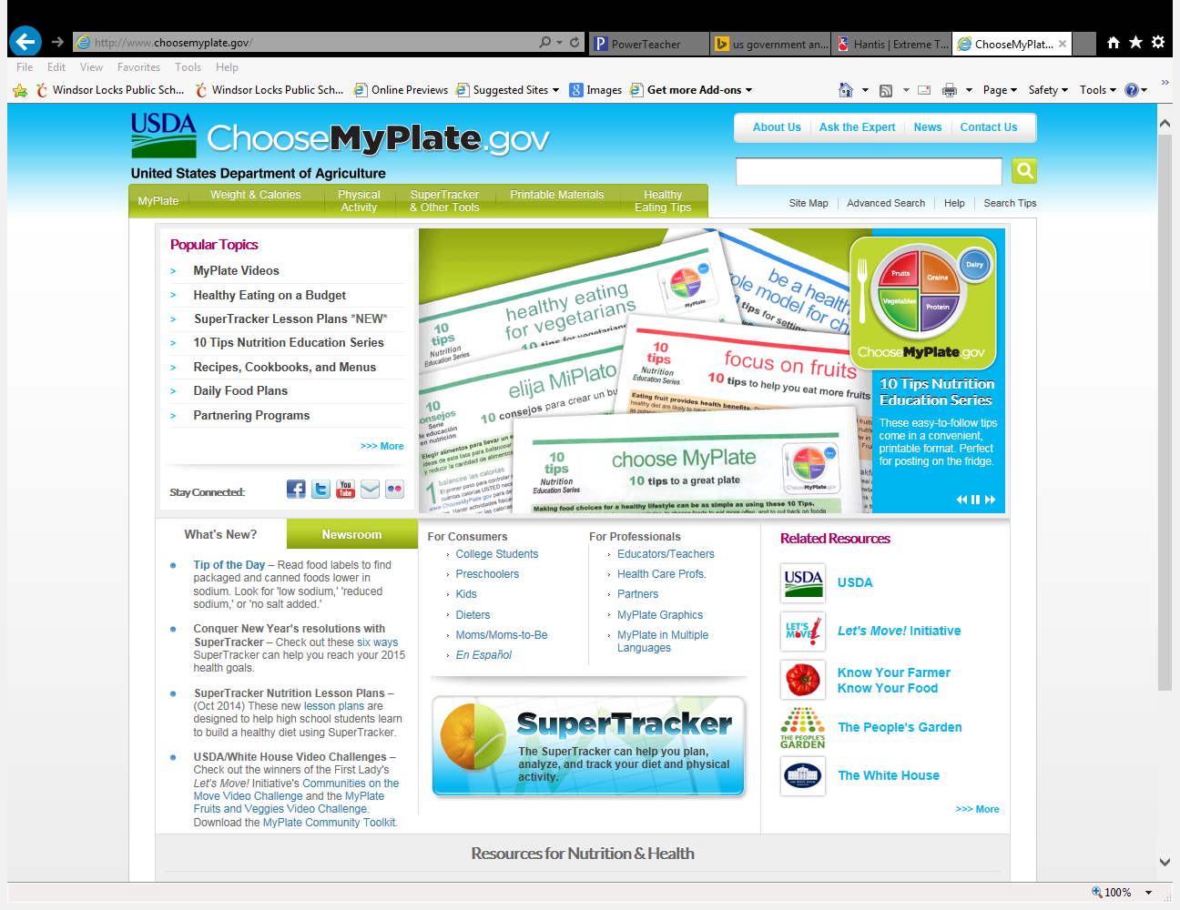
How Does it Work?
The Michelle Obama Campaign created a much more user friendly interactive website that can be used for all ages. Take notes.
Chosemyplate how to guide

Slide 27
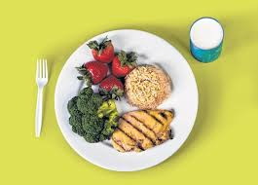
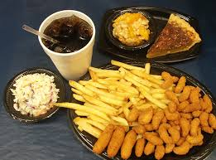
Questions?
Compare and Contrast the food choices.
How does each one compare to the chose my plate plan?
How does your food choices compare to the my plate?

