Slide 1
Ingredients Exposed

Slide 2
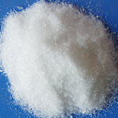
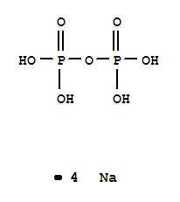
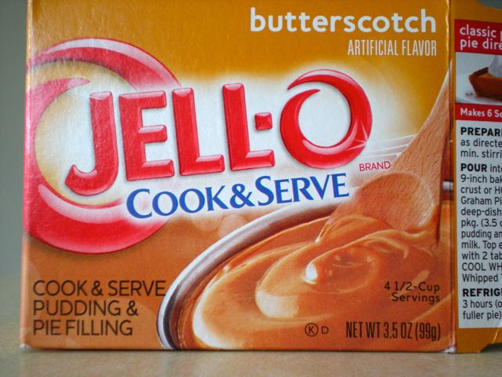
tetrasodium pyrophosphate
tetrasodium pyrophosphate is a type salt made up of pyrophosphoric acids.
The salt is generally used in different soaps and detergents, but in this case it was found in a package of Jell-O Butterscotch pudding.

Slide 3
Hazards
The tetrasodium pyrophosphate is generally okay to eat. However the substance is very hazardous when it comes to skin contact and especially eye contact.
When this substances arrives into contact with your skin it can cause swelling, irritation, and even severe inflammation.
A safer buffering agent that can be used instead of this substance is sodium acetate tyihydrate. It is much weaker and does not have as much hazards as this substance.

Slide 4
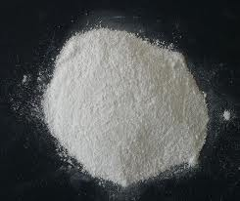
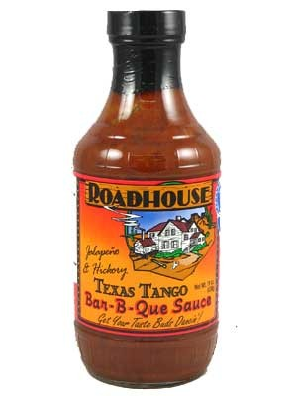
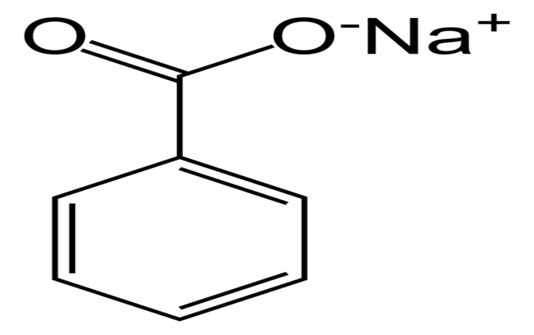
sodium benzoate
Sodium Benzoate is mostly used for food preservation along with antiseptic.
This time I found sodium benzoate in a can of Road House Hot Sauce. It is a salt that is not soluble in cold water and does have different effect on your body .

Slide 5
Dangerous?
Sodium Benzoate can lead to sickness in very large amounts. This salt is a prime ingredients in many kinds of soft drinks and food dyes.
As a result of being in food dyes, there has been a lot of rumors of this substance increasing ADD in the childhood audience.
Recently in Australia there have been an invention of which a scientist could have found a natural alterative. Natural blends of herbs could prove to have the same taste and be much more forgiving on the human body.

Slide 6
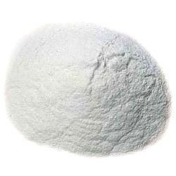
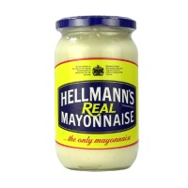
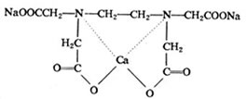
Calcium Disodium (EDTA)
Calcium Disodium or known as Ethylenediaminetetraacetic is actually not a salt, but a type of acid.
It is mostly used a vitamin booster but can have serious effects on the human body. I found this substance in a jar of Mayonnaise

Slide 7
Consequences
This substance can lead to mal-absorption and lower vitamin levels in the body. It can also cause different allergic reactions with the body. These reactions could anything to swelling and fever or cause death.
So far there is no real Alternative in this substance. Sense it is used for anything to vitamin enhancer to a quality preserver. Mostly just natural alternatives live Olive or coconut oils will do well.

Slide 8
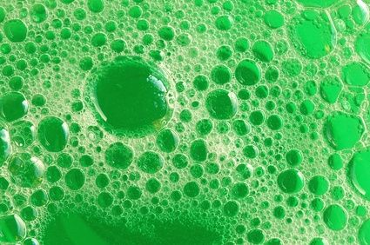
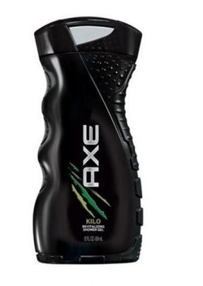
Sodium laureth sulfate
Sodium laureth sulfate is a soaking agent that is used in many different detergents and personal care products. The substance is cheap and very easy to use, thus making it very popular.
But even though the substance is cheap and easy it can bring dangerous sicknesses to the human body. I found this substance in a bottle of Body wash.

Slide 9
Deadly Concentrations
Large concentrations of this substance can lead to highly irritate skin and cause damage to it. As a result of this being in a liquid state the substance is very easy to get into your eyes. When the substance gets to your eyes it can cause permanent damage. laureth also can’t be metabolized by the liver.
SODIUM COCO SULFATE is a significantly greater product because it is much more safe. The natural use of coconuts help the skin and body instead of factory made products.

Slide 10
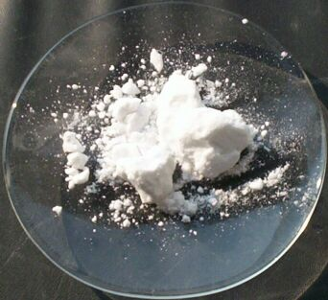
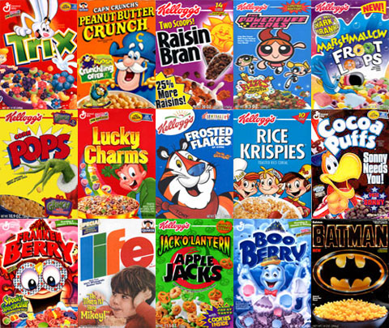
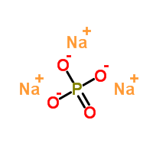
Tripotassium phosphate
Tripotassium phosphate is a foaming, whipping and a emulsifier. It is water soluble and is classified as a ionic salt, it is mostly used as food additive.
This isn't a very deadly substance but does have irritating effects on the body. I found this substance in different boxes of brand cereals.

Slide 11
Extreme Stomachaches
While this substance isn't very bad for the human body, it still has effects on the stomach. While very large amounts of this substance you will feel lots of abdominal pain and it can actually effect the gastric mucosa of the human stomach.
While this substance is actually quite safe, you still should eat it in large amounts. The body will respond with very intense pain in the abdominals and stomach regions

