Slide 1
Chemistry Mixture Project

Slide 2
Household product
Colgate Total Antibacterial & Whitening Toothpaste Ingredients
Ingredient | Alternative Names | Purpose/Properties of the Ingredients | Health Risks
Triclosan | antimicrobial agent | the ingredient that gives Colgate Total toothpaste its antibacterial properties | There is some concern that triclosan could cause cancer. The concern is based on when triclosan is mixed with chlorinated water in a laboratory setting it produces chloroform gas
Fluoride | The form used in Colgate Total toothpaste is sodium fluoride | anticavity ingredient | The American Dental Association's rules about whether a toothpaste is considered clinically effective relates to whether the toothpaste contains fluoride.
Sodium Lauryl Sulfate | inactive ingredient found in Colgate Total | It is a chemical compound that acts as a foaming agent. | Like triclosan, there a concerns that sodium lauryl sulfate can cause cancer.
Saccharin | artificial sweetener | is used to help give the toothpaste a pleasant taste | There is some controversy surrounding saccharin, as it has been found to cause bladder cancer in laboratory rats

Slide 3
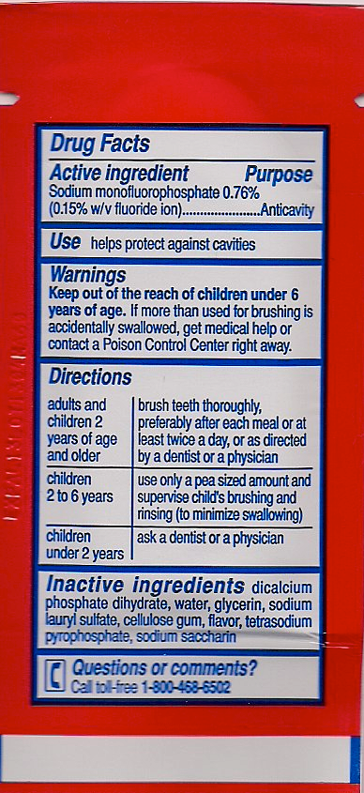

Slide 4
Organic alternitive
Ingredients:
6 tsp. baking soda
1/3 tsp. salt
4 tsp. glycerin
15 drops of peppermint extract
The baking soda works to whiten and cleanse your teeth. The salt has the same effect as an antiseptic, cleaning the teeth. Glycerin is a base to help with flavoring and make the mixture thick and creamy. The peppermint is used for flavoring and to provide fresh breath.
Process:
Combine the ingredients in a small storage container. Stir the mixture until it forms a thick consistency. This natural toothpaste can be used daily, just like other toothpastes. Store at room temperature in a plastic storage container or jar.

Slide 5
Food Product: Popsicles
Ingredient | Alternative Names | Purpose/Properties of the Ingredients | Health Risks
GUAR GUM | Cyamopsis psoraloides, Cyamopsis tetragonoloba | In foods and beverages, guar gum is used as a thickening, stabilizing, suspending, and binding agent | Because guar gum might affect blood glucose levels, there is a concern that it might interfere with blood glucose control during and after surgery.
locust bean gum | Ceratonia siliqua | locust bean gum is primarily used as a means to thicken food products. | LBG can be used to replace fat, and lower cholesterol
high-fructose corn syrup | HFCS | common sweetener in sodas and fruit-flavored drinks. | can contribute unwanted calories that are linked to health problems, such as weight gain, type 2 diabetes, metabolic syndrome and high triglyceride levels. All of these boost your risk of heart disease.
Yellow No.5 | E102, tartrazine | used to color our food | Known to provoke asthma attacks, urticaria (nettle rash), altered states of perception and behaviour, uncontrolled hyper agitation and confusion, wakefulness. Is also known to inhibit zinc metabolism and interfere with digestive enzymes.
Yellow No.6 | E110, Sunset Yellow | used to color our food | Known to provoke allergic reactions such as abdominal pain, hyperactivity, hives, nasal congestion. . .

Slide 7
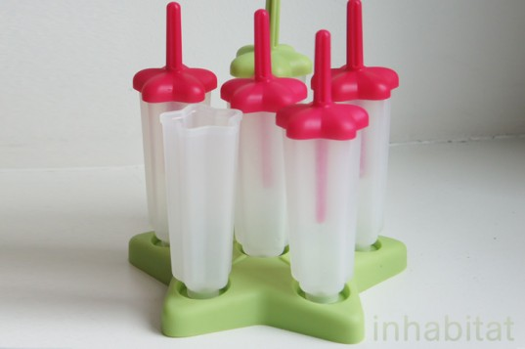
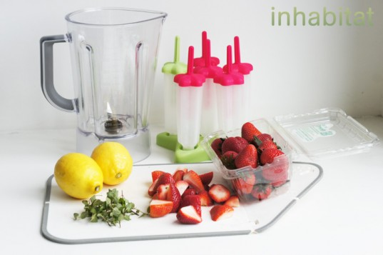
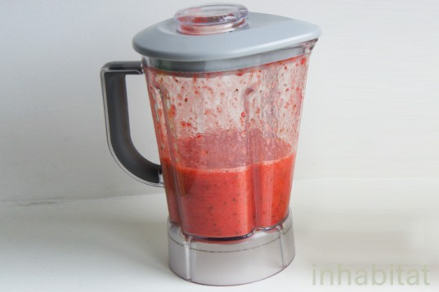
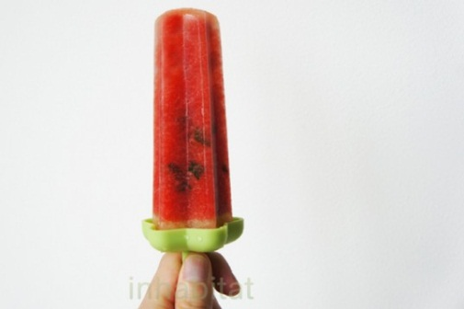
Organic Popsicles
STEP 1: Acquire freezer popsicle molds.
STEP 2 :Take a look around in your fruit basket, herb garden, refrigerator and freezer, and see what excess fruits and veggies you may have to work with and start there. Any summer fruit or berry (strawberries, raspberries, blueberries, blackberries, watermelon, cantaloupe)
STEP 3: Grind it all up in the blender
STEP 5: Pour your concoction into your popsicle
molds.
STEP 6: Freeze for 2-3 hours or more in your
N freezer.
STEP 7: ENJOY!

Slide 8
Sources
http://www.livestrong.com/article/127011-ingredients-colgate-total-toothpaste/
http://www.ehow.com/info_8590554_colgate-antibacterial-whitening-toothpaste-ingredients.html
http://www.ehow.com/way_5278502_recipe-natural-toothpaste.html
http://www.wisegeek.com/what-is-locust-bean-gum.htm
http://www.quirkyscience.com/what-is-locust-bean-gum/
http://www.huffingtonpost.com/dr-mark-hyman/high-fructose-corn-syrup-dangers_b_861913.html
http://www.mayoclinic.com/health/high-fructose-corn-syrup/AN01588
http://www.answerbag.com/q_view/911618
http://inhabitat.com/how-to-make-homemade-healthy-organic-popsicles/

